Slide 1
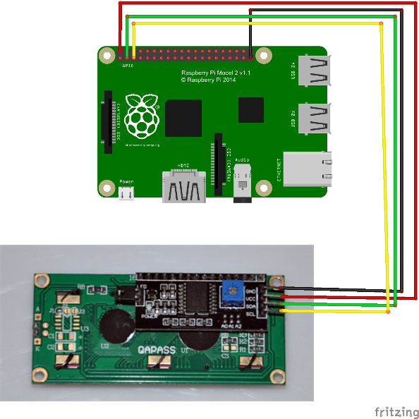
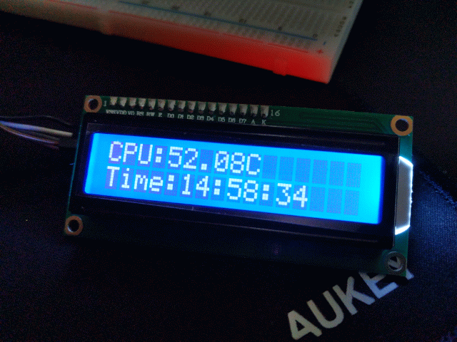

I²C LCD
Serial to I²C board connected for ease of use
Only 4 wires needed VS up to 16 needed otherwise
“Hardest” part is identifying the I²C address to be used.

